Slide 1

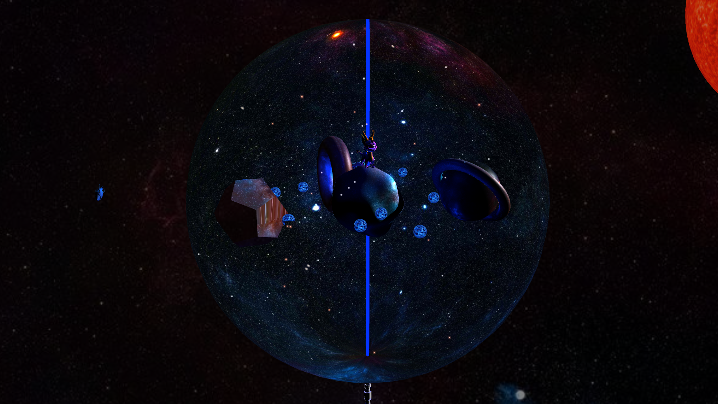


Messy Orbit Galaxy
Introduction to to Computer Graphics,
João Afonso Pereira Ferreira 103037

Slide 2
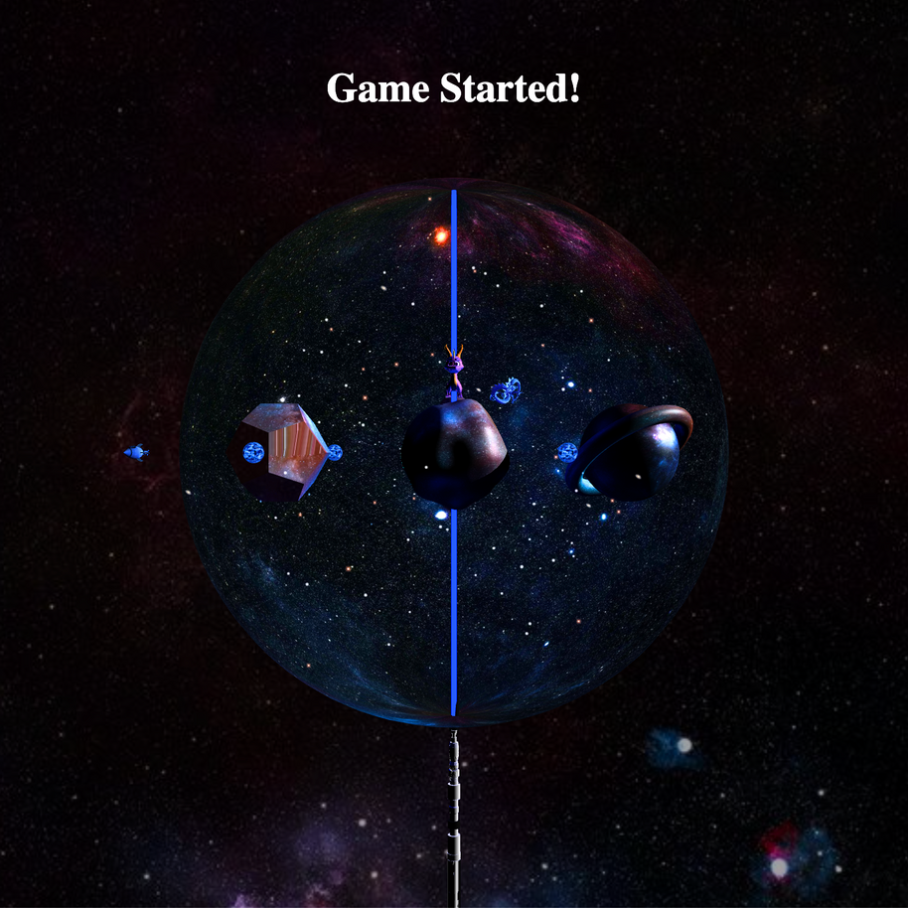

Project About
A game developed in ThreeJS;
The user can:
Toggle visibilities;
Increase/decrease illumination;
Play the game;
Explore the space with 3rd person view rocket;
Game url:
https://joaoafonso02.github.io/MessyOrbitGalaxy_ICG/source/
Project Github Repository:
https://github.com/joaoafonso02/MessyOrbitGalaxy_ICG/

Slide 3










Goals - What to expect
CREATE GALAXY
ILLUMINATION
ANIMATIONS
GAME RESULT

Slide 4



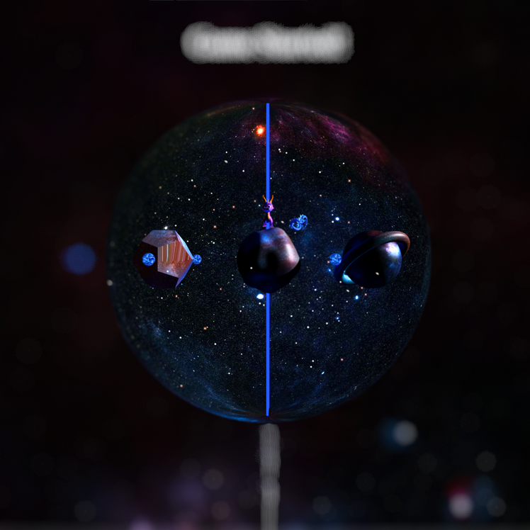
Scene Composition
GLTF Load Models Imported
Objects rotate around theirselves
Stars Animation using noise ThreeJS
Blue Lightsaber (Light Source)
Easter eggs inside the planets
Sphere background nucleus
Gems designed with Gem texture

Slide 5

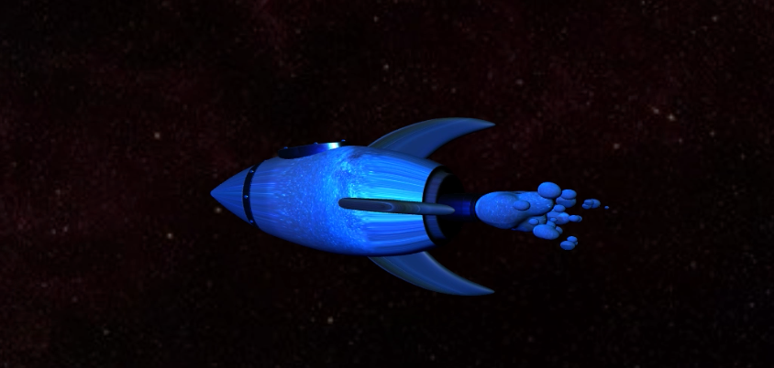
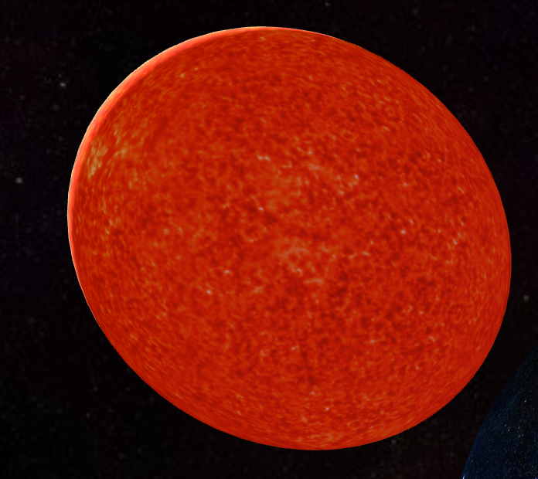
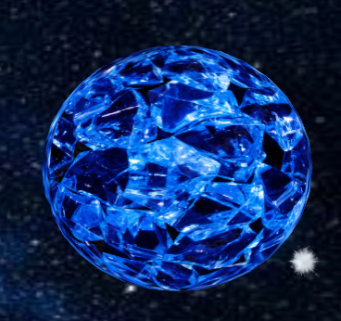
Scene Composition
Rocket
Sun
Gem
GTLF Model
GLTF Model
Made using textures
Controlled by player
One of the Light Sources
Pickable gems to complete the game

Slide 6
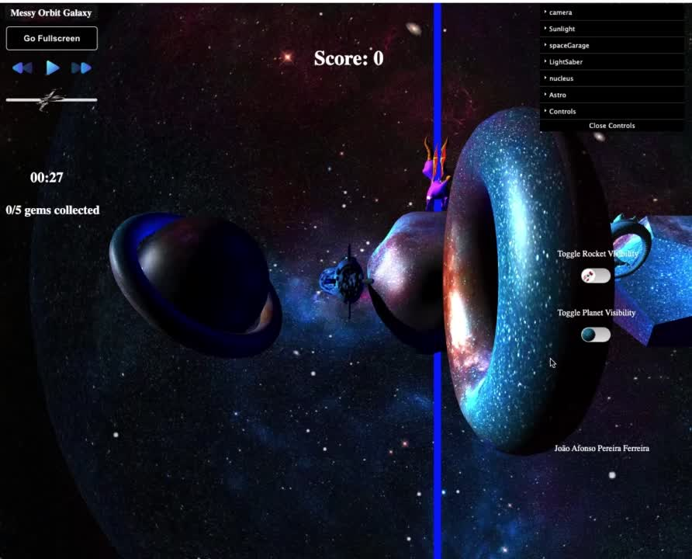


Models and Animations

Slide 7
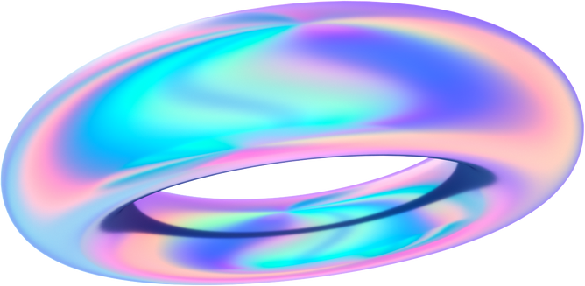
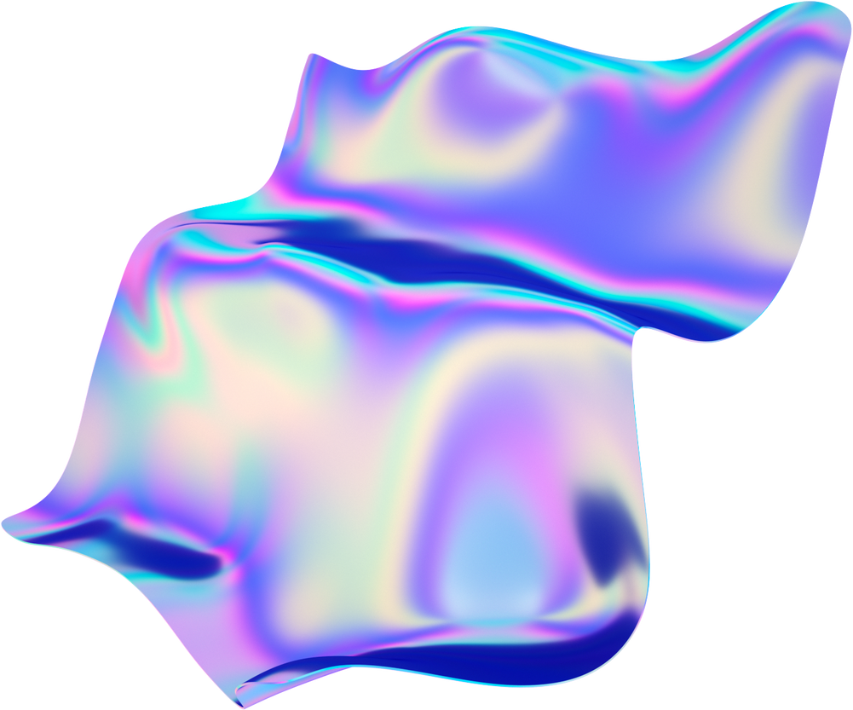

Roadmap
P1
P2
P3
Idea Generation
Related Work Research
Concept
ThreeJS Library Exploration
Low-Fidelity Prototype(paper)
Build Game
Development & Implementation
Add Features to game
Testing

Slide 8
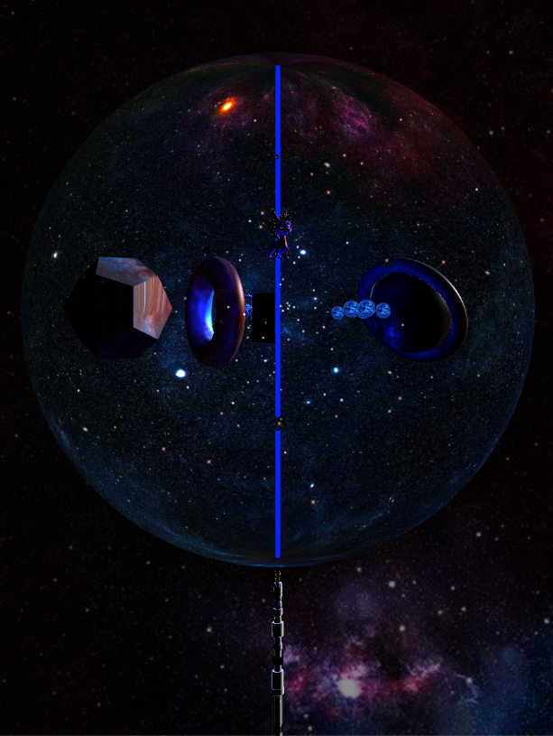
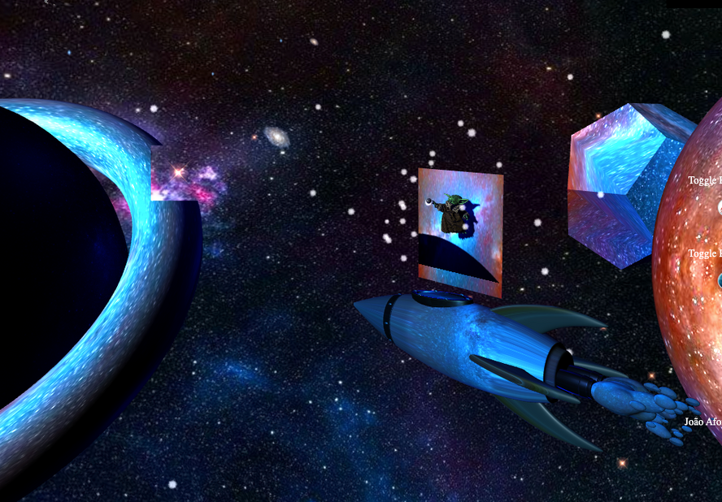
Illumination
LightSaber
Sun
Shadows
GTLF Model
GLTF Model
By illumination
Blue LighSaber modified in Blender (original green with some defects)
Sun from Fabric 3D Models
The "Saturn planet" it's in front of Grogu and panel

Slide 9

User Interaction
Orbit Controls from ThreJS
Rocket Movement (keyboard - Arrow keys and W, S)
Possible to explore the scene if user decides to leave the game
User can play the game

Slide 10
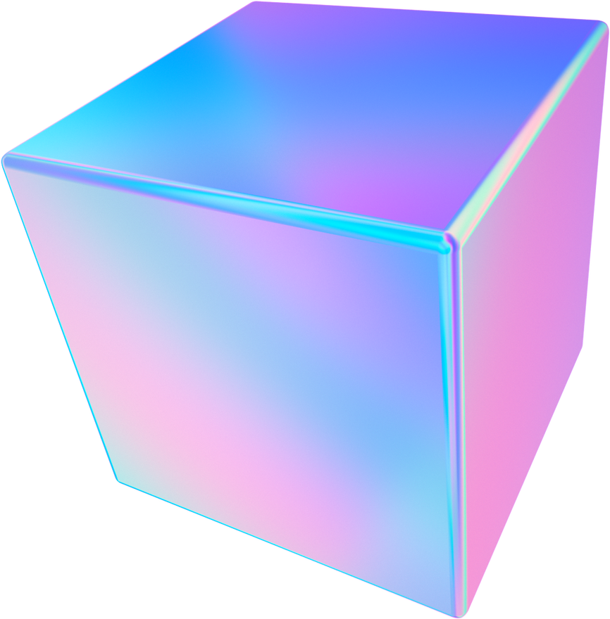
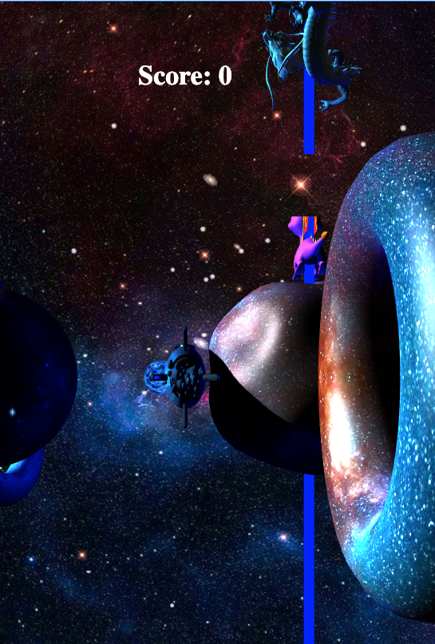
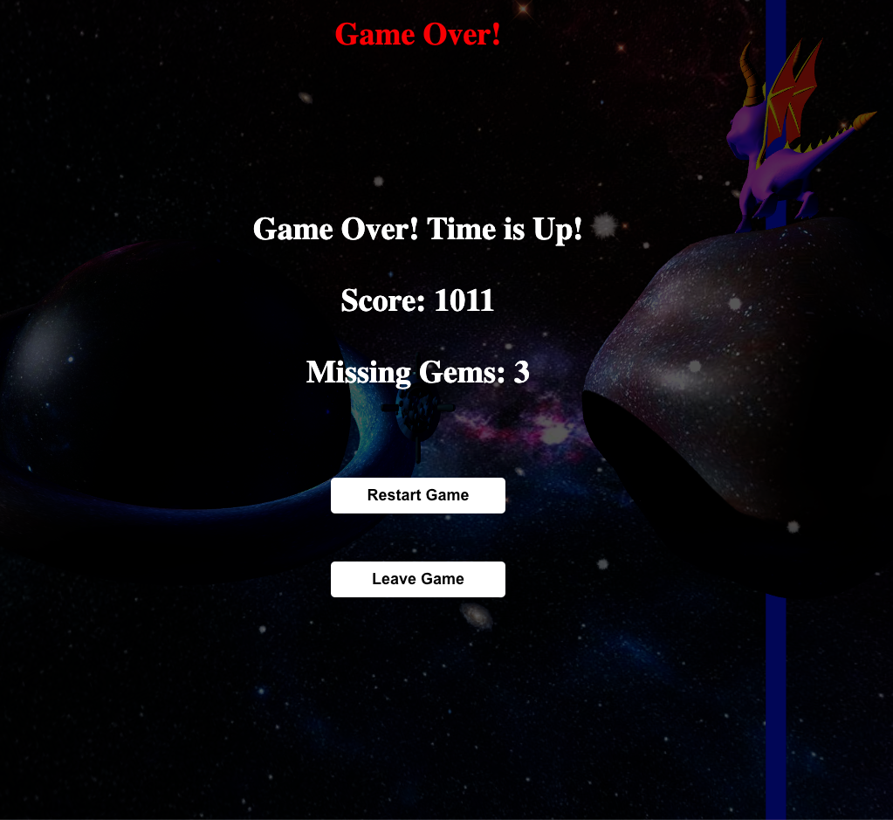

Game About

Slide 11







Development & Conclusions
Code Organization - in classes, functions and imports
GitHub - keep project's versions
Problems/Difficulties
Discussion & Reached Initial Goals
Waar
FANTASY ISN'T FICTION

Slide 12
References
Sketchfab 3D models. Retrieved from https://sketchfab.com/
ThreeJS Documentation. Retrieved from https://threejs.org/docs/
W3 Schools. Retrieved from https://www.w3schools.com/
Youtube Video - Import GLTF Model. Retrieved from https://www.youtube.com/watch?v=WBe3xrV4CPM&pp=ygURaW1wb3J0IGdsdGYgbW9kZWw%3D
Youtube Video - ThreJS Module Import. Retrieved from https://www.youtube.com/watch?v=PZsKzYoIaZA&pp=ygUVcHJvYmxlbXMgd2l0aCB0aHJlZWpz

Slide 13
João Afonso Pereira Ferreira
Thank You
ferreiraafonsojoao@ua.pt
103037
MIECT

